Slide 1



AI PolicyChat
94812 - Team#5 Report
Cleon Sun
Abhijit Verma
Yan Luo
Joey Xie
Valerie Yuan
Jiaying Qian

Slide 2
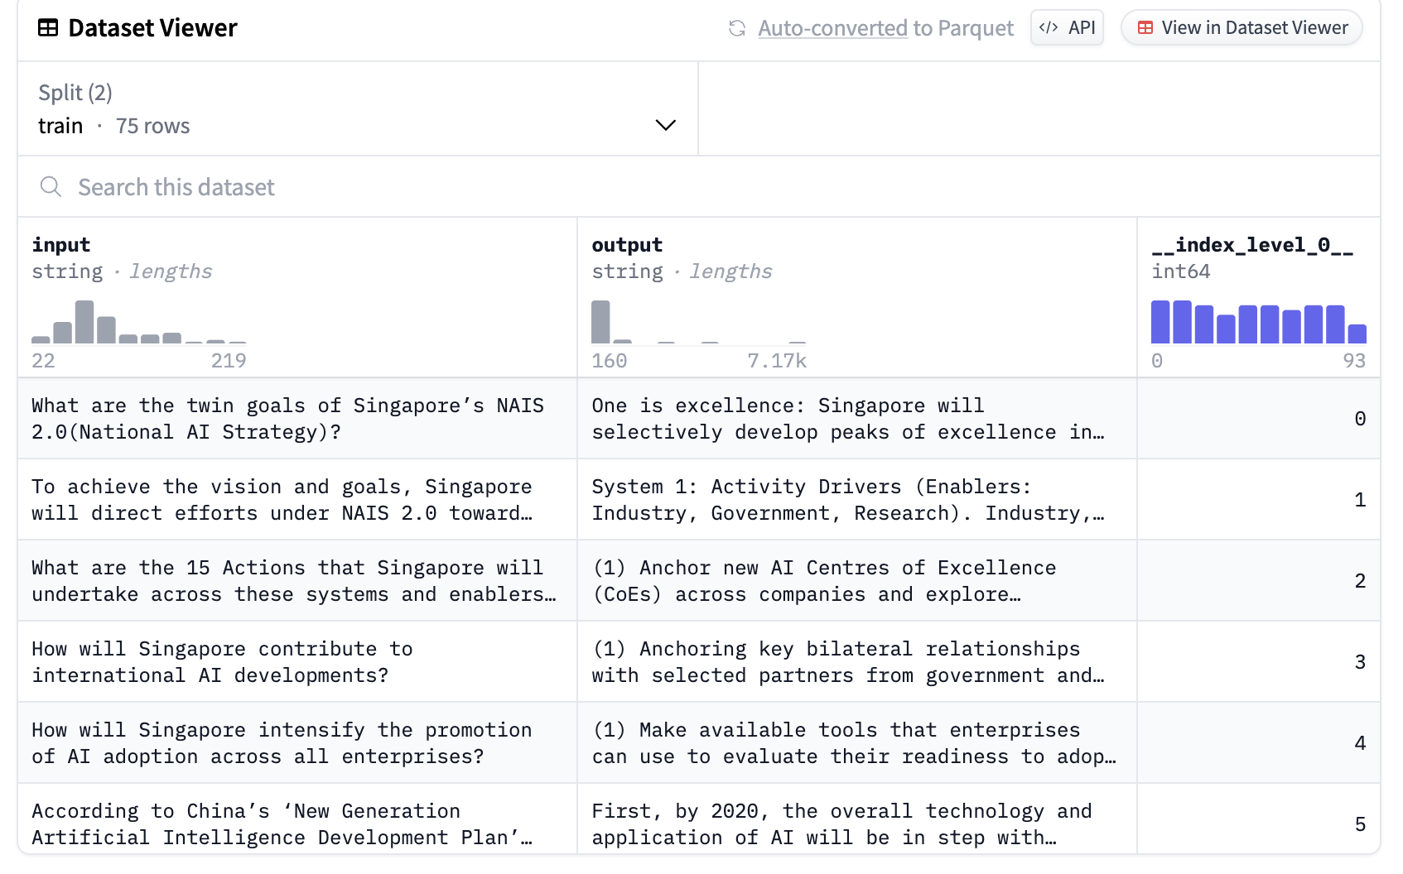

Data Collection
We started by collecting 20 AI policy documents from various trusted sources listed on our course's Canvas page;
Made Questions: We came up with around 100 questions that cover a broad range of AI policy topics;
Found Answers: For each question, we found an answer in our collected documents.
Pushed to Hugging Face hub.

Slide 3
Policy Chat
Question:
Why is international cooperation on AI important?
Raw Llama:
</s><s> nobody knows
International cooperation on AI is important for several reasons:
1. **Sharing knowledge and resources**: By working together, countries can share their expertise and resources in AI, leading to faster progress and more innovative solutions.
2. **Addressing ethical and social implications**: AI raises complex ethical and social implications, such as privacy, bias, and job displacement. International cooperation can help address
After Fine tuning:
International cooperation on AI is important because it can help address global challenges, such as climate change, pandemics, and economic inequality, more effectively than any one country could alone. It can also help ensure that AI is developed and used in ways that are ethical, transparent, and respectful of human rights.

Slide 4
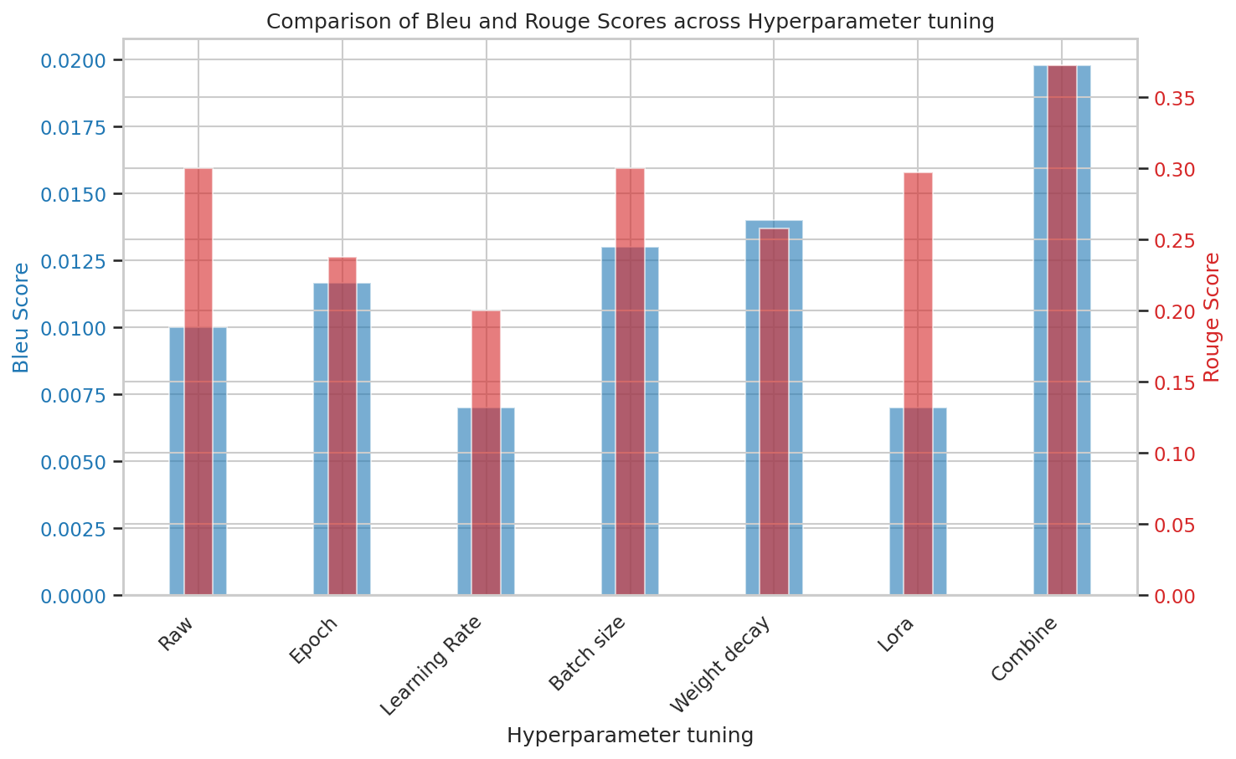
Hyperparameter Tuning

Slide 5
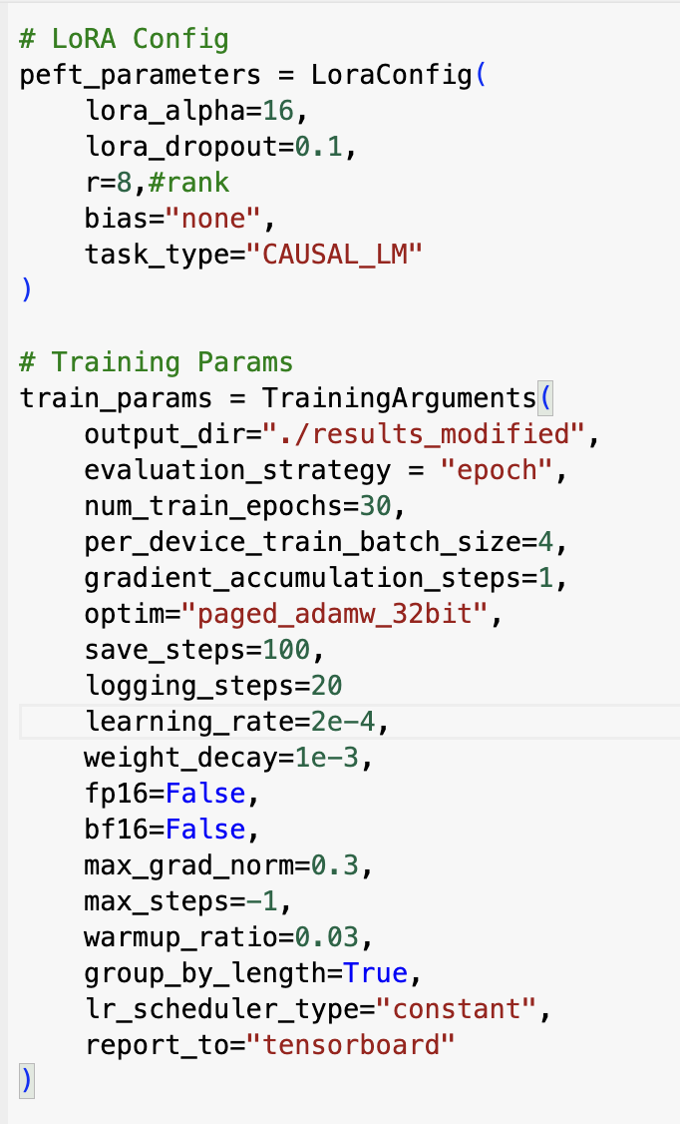
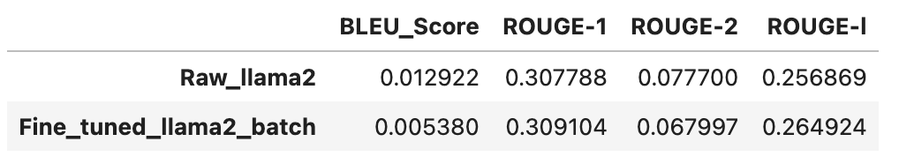
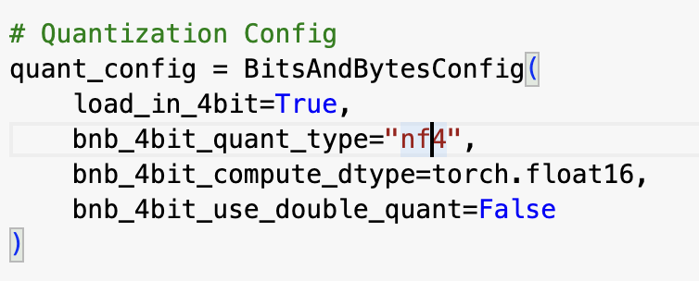
Baseline Model

Slide 6
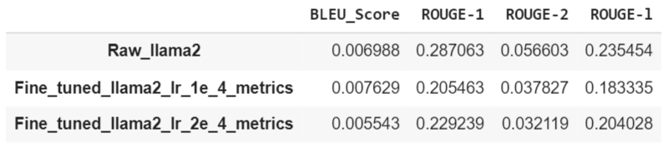
Learning Rate
Critical role of learning rate in Fine-Tuning
Determines how effectively the model adapts to new data
Balances knowledge retention with new information assimilation
Prevents overfitting to maintain generalization
Experimentation with different learning rates (1e-4 & 2e-4)

Slide 7
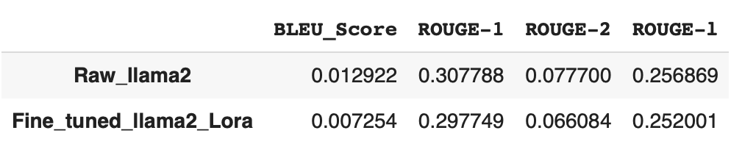
Lora Hyper-parameter
What Lora is & What We Chose
lora_alpha: This parameter controls the scaling factor applied to the low-rank matrices in LoRA. It is used to adjust the magnitude of the updates to the original model parameters.
lora_dropout: This parameter specifies the dropout rate applied to the low-rank matrices in LoRA. Dropout is a regularization technique used to prevent overfitting by randomly setting a fraction of the input units to 0 during training.
r: This parameter defines the rank of the low-rank matrices in LoRA. The rank determines the number of columns in the low-rank matrices, which in turn controls the amount of parameter reduction.
bias: This is a boolean parameter that indicates whether to include bias terms in the low-rank adaptation.
lora_alpha | lora_dropout | r | bias
32 | 0.2 | 8 | none
How Lora Performs

Slide 8
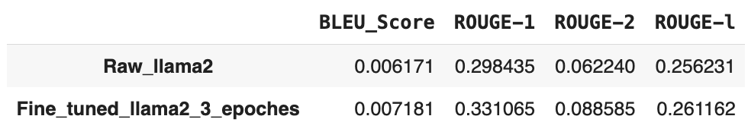
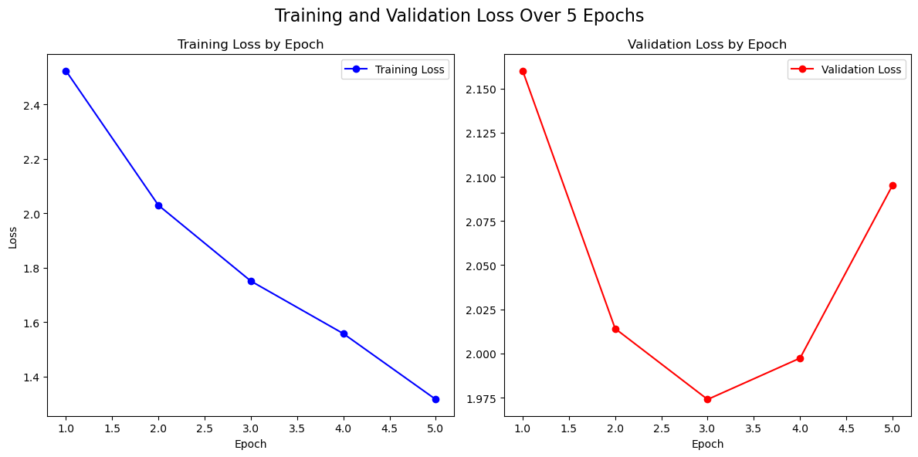
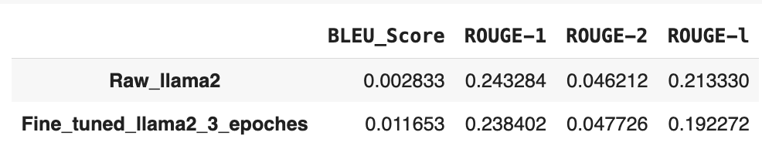
Number of Epochs
Base model: NousResearch/Llama-2-7b-chat-hf
Base model: meta-llama/Llama-2-7b-chat-hf
num_train_epochs=3 is the best.

Slide 9
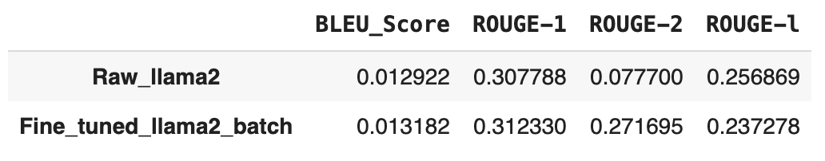
Batch Size
Gradient accumulation = 2
Larger batch size usually makes gradient approximation more accurate and stabilize training. Our baseline batch size is 4. Because T4 GPU RAM is limited to 14 GB, large batch like 8 cannot fit into the GPU.
Gradient accumulation is a technique used to train models with large mini-batches that cannot fit entirely into the GPU memory at once.
We can backward the gradient after two gradients of two small batches are calculated and add them to get a large batch gradient, and update the model.

Slide 10
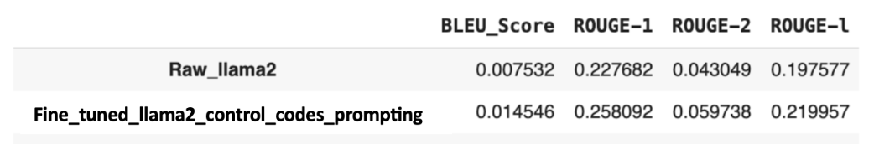
Weight Decay
How does weight decay affect the model? L2 Regularization.
The weight decay parameter is a regularization technique used during the training of neural networks, and it serves multiple purposes:
Preventing Overfitting
Improving Generalization
Stabilizing Training
Our experiments with varying weight decay values from 0.0001 to 0.1 during the training of the LLaMA model demonstrated that this parameter had little effect on the training loss, indicating a low influence on the model's learning across the dataset used.

Slide 11
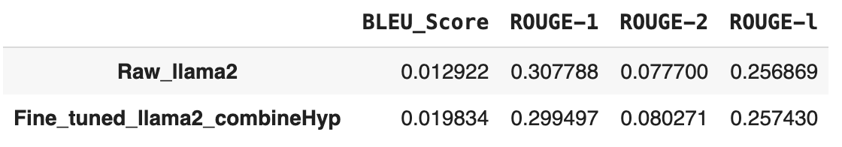
Combine hyperparams tuning
Lora_rank=16,
Gradient Accumulation=2,
Learning_rate=1e-5,
Weight_decay=2e-3,
Max_grad_norm=0.1,
Epoch=10

Slide 12
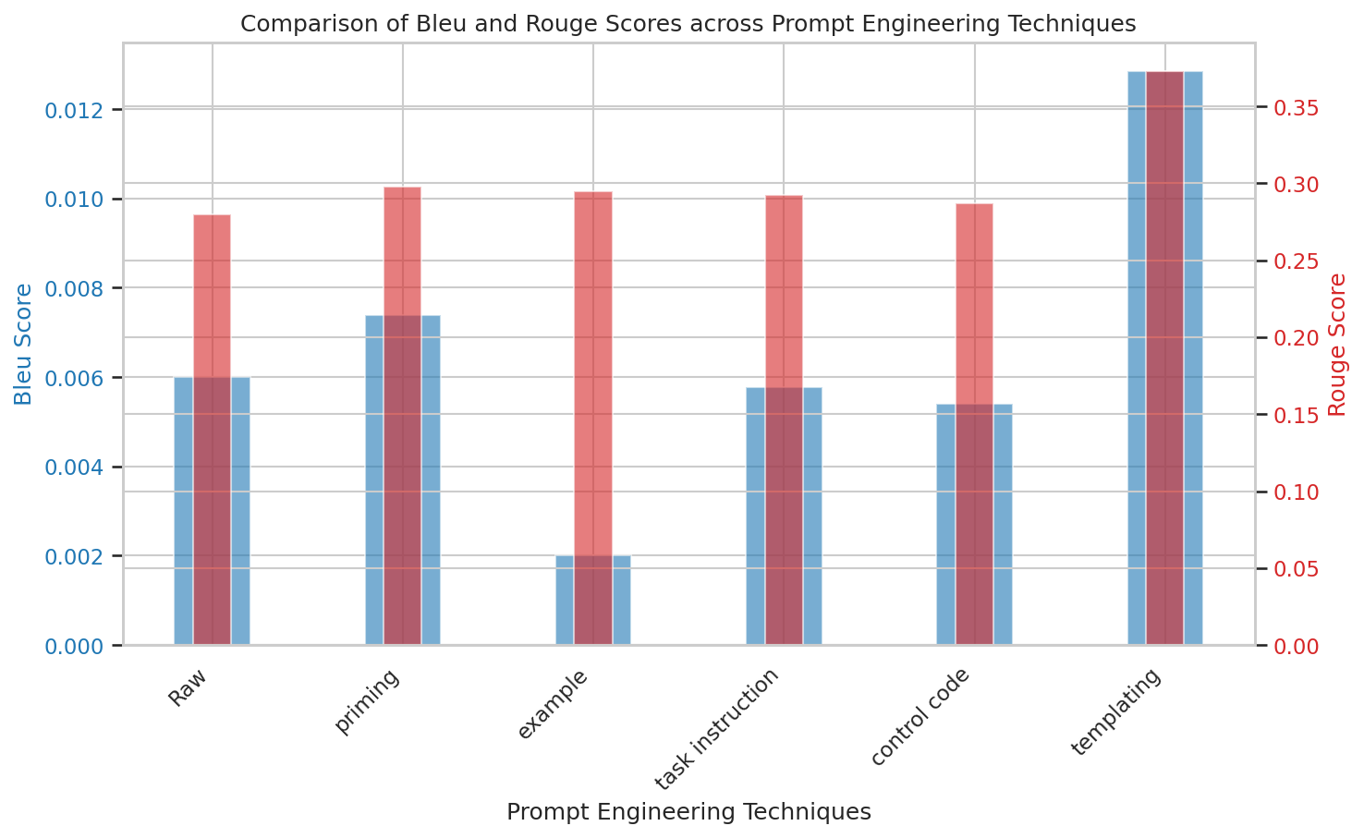
Prompt Engineering

Slide 13
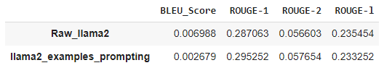
Examples
Adopting fixed example method for Examples prompting technique
Mitigates risks of biased guidance in model responses
Provides a consistent template for quality and format
Ensures stylistic uniformity without content influence
How it performs:

Slide 14
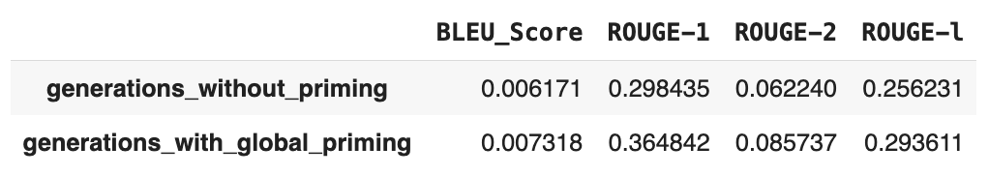
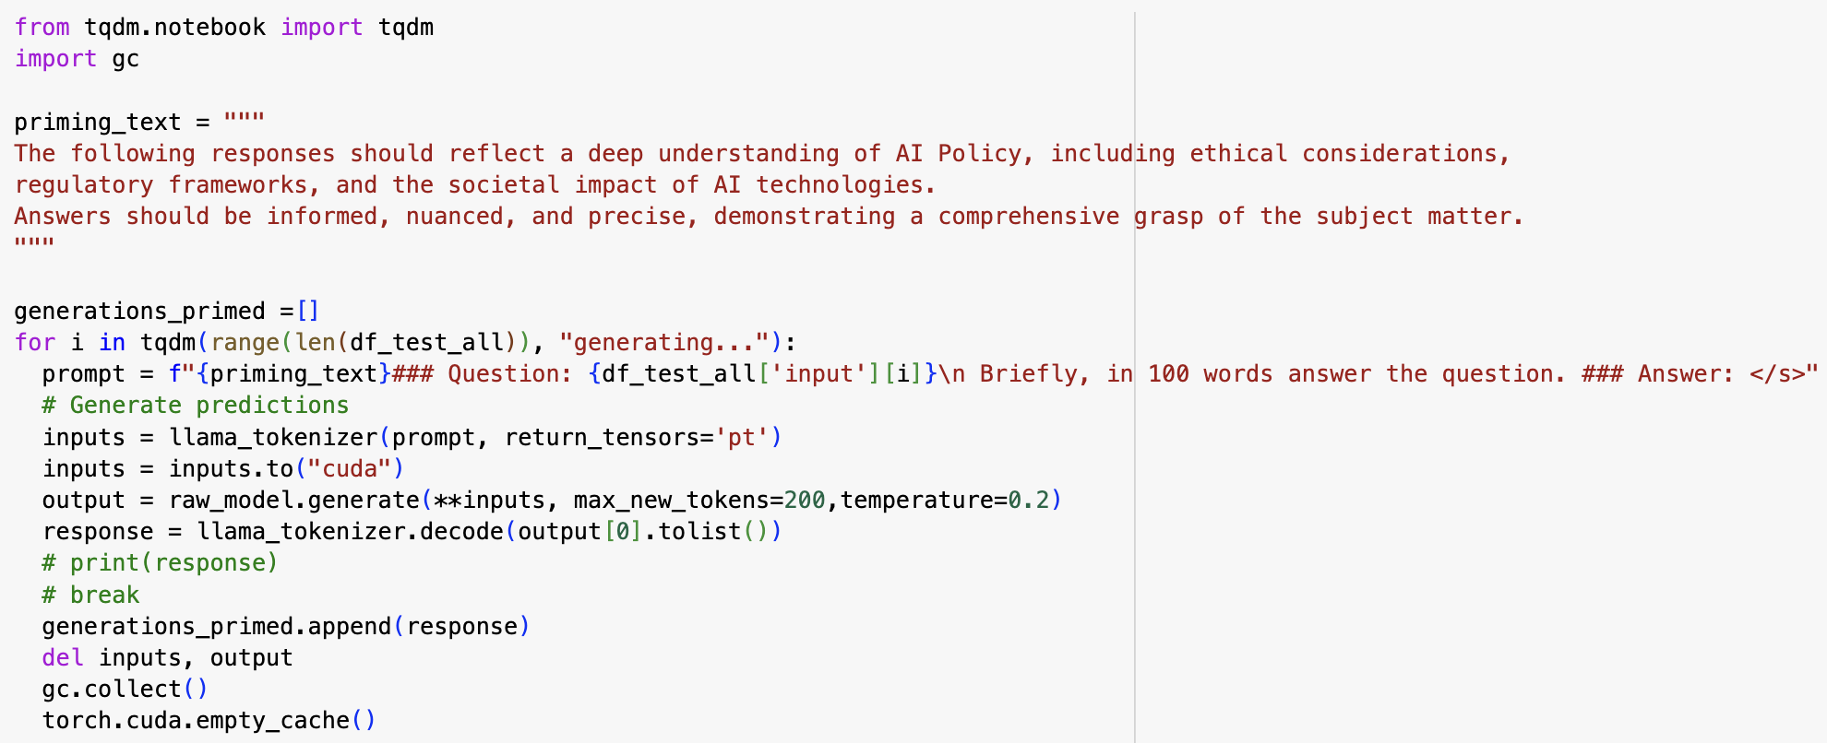
Priming

Slide 15
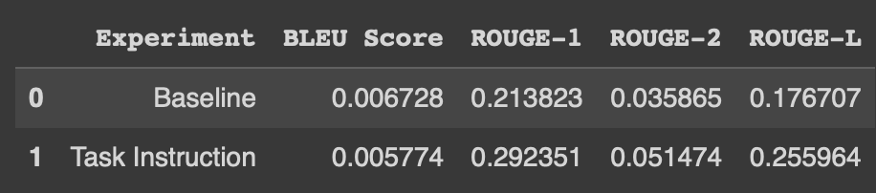
Task Instruction
What Task Instruction Is:
Task Instruction: Providing specific task instructions showed a balanced improvement across all metrics, suggesting that task instruction might be a more effective approach than individual priming in certain contexts.
In the experiment, before the question, we add “Based on your knowledge, please answer the question:”
How it performs:
Notes:
Task instruction is a technique used in natural language processing to provide explicit guidelines or directives to a language model, outlining the specific task it needs to perform. This approach helps the model understand the context and objective of the task, leading to more accurate and relevant outputs.

Slide 16
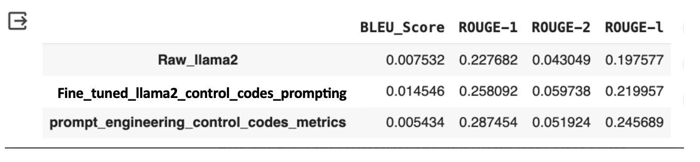
Control Codes Prompting
What Control Codes Prompting Is:
Control Codes: Special instructions or tokens we prepend or append to our input prompt to guide the model's generation towards a desired format, tone, or content type.
For the Llama-2 7b model, this involves specifying the type of response needed (e.g., factual, analytical, policy recommendation) or indicating the focus area (e.g., AI ethics, regulation frameworks, implementation strategies).
Example: [International Cooperation] Why is international cooperation on AI important?

Slide 17
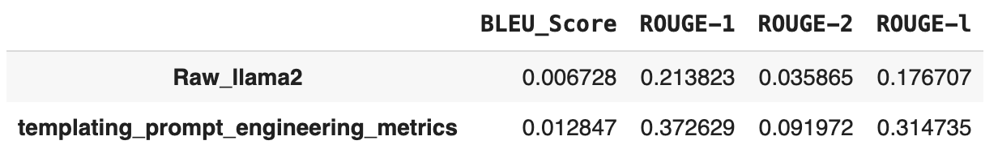
Templates
What Control Codes Prompting Is:
For example:
The original prompt is: “How does the European Union classify AI systems under its AI Act, and what are the implications for "high risk" AI systems?”
Template:
Discuss the main concerns raised by critics regarding the European Union's AI Act, particularly focusing on its potential impact on innovation and competitiveness within the EU. Analyze how the regulation might hinder or foster technological advancement and the competitiveness of European AI industries on a global scale.

Slide 18
Evaluation Metrics
Automatic Metrics
BLEU
ROUGE
Human Evaluation
Relevance
Coherence
Our process of human evaluation across different fine-tuning experiments and prompt engineering techniques:
https://docs.google.com/spreadsheets/d/17-JDgSJSxjbH-zk6wxtRN3Y2OmibVuHddKCz7MqQaMQ/edit#gid=700621598

Slide 19
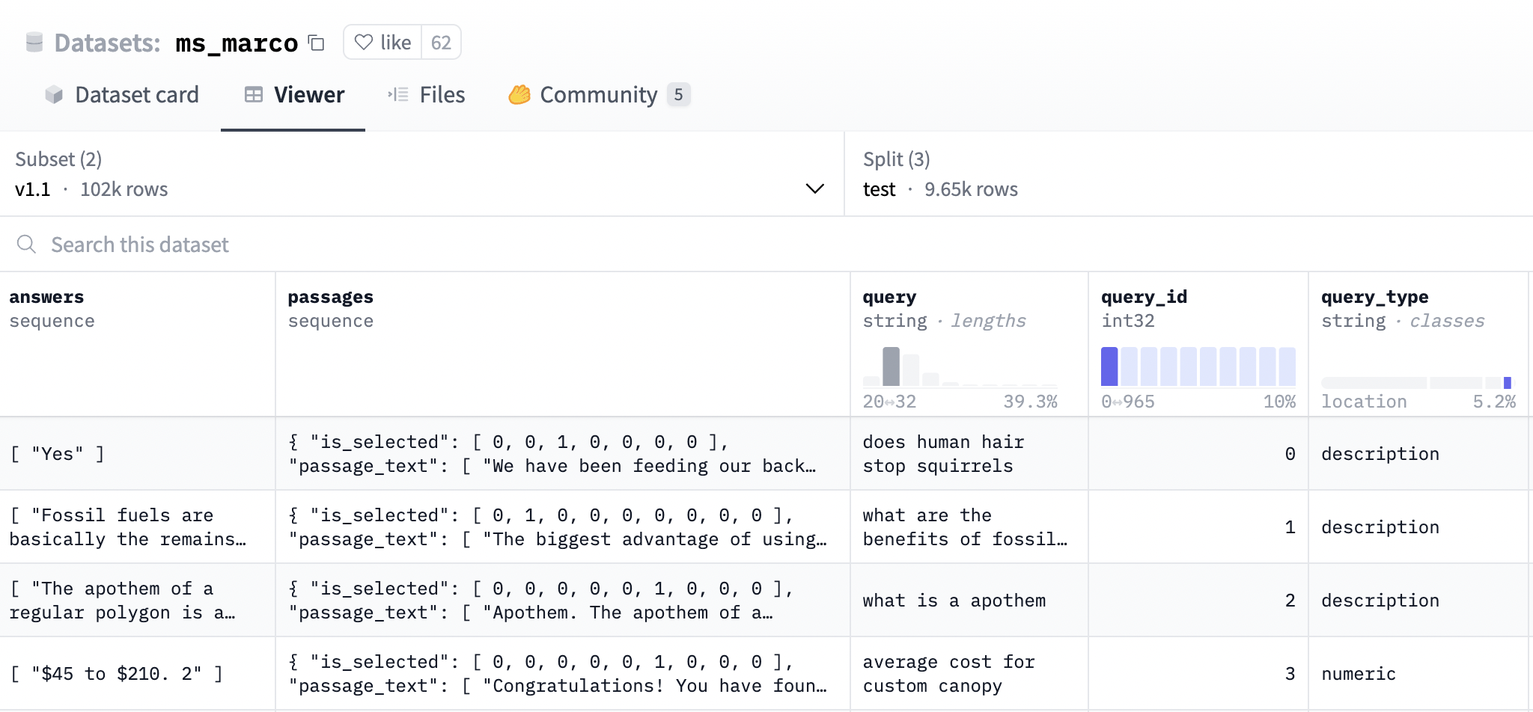
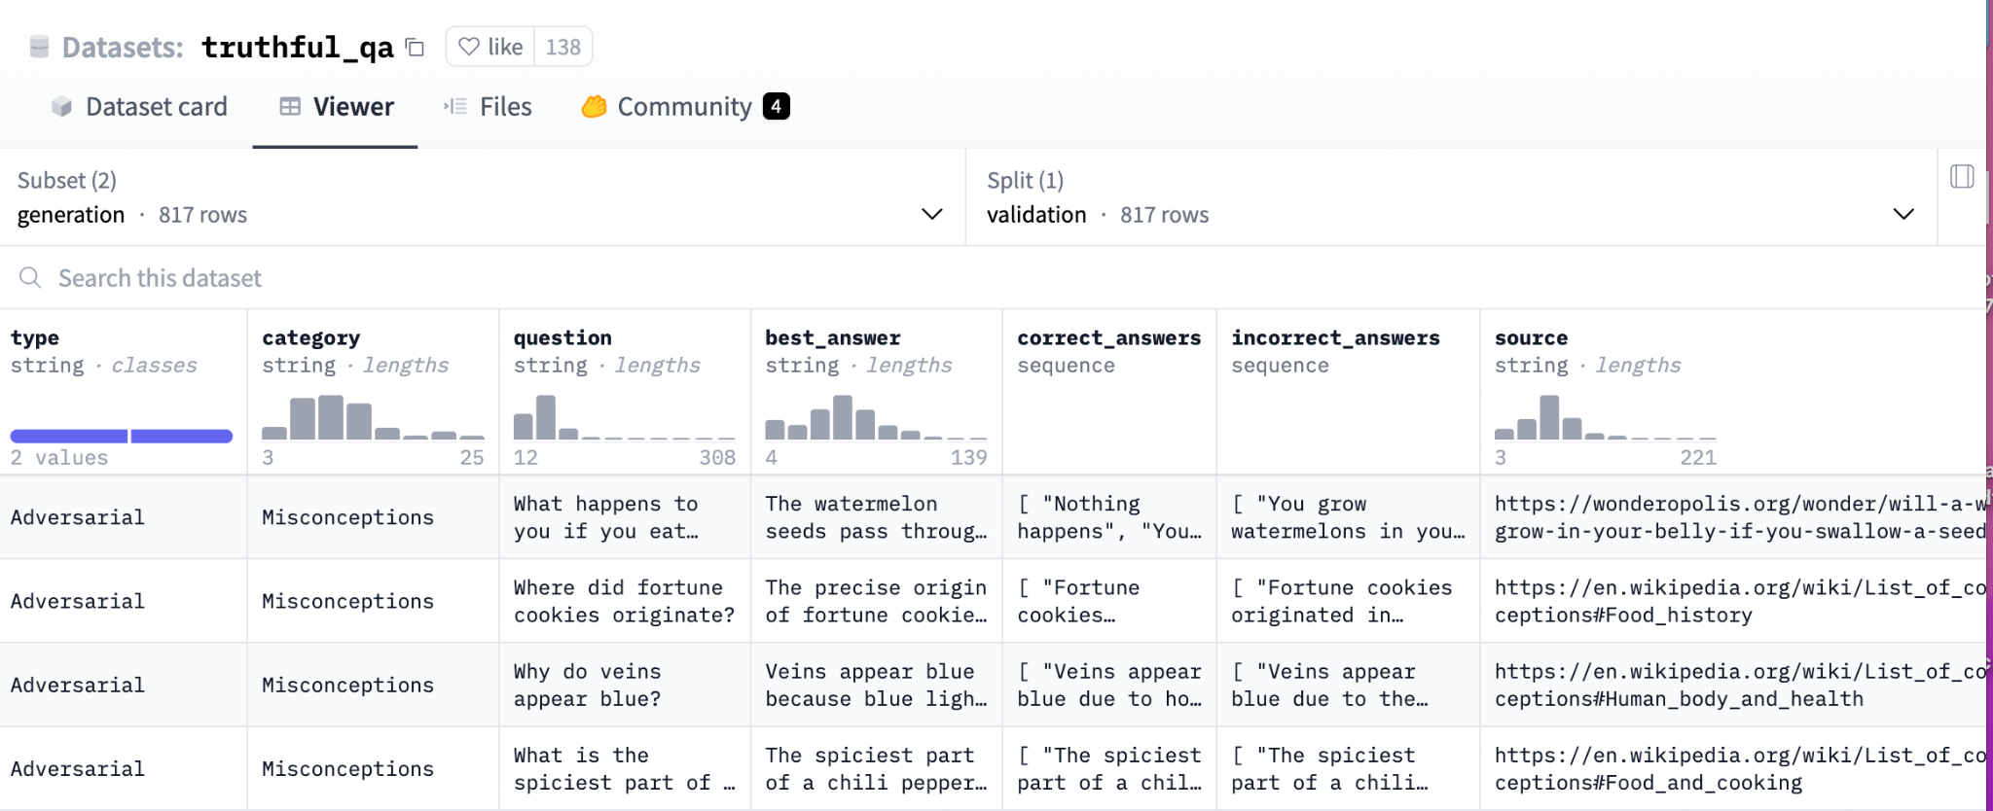
Benchmarking datasets and results
ms_marco
a question answering dataset featuring 100,000 real Bing questions and a human generated answer
truthful qa
comprises 817 questions that span 38 categories, including health, law, finance and politics

Slide 20
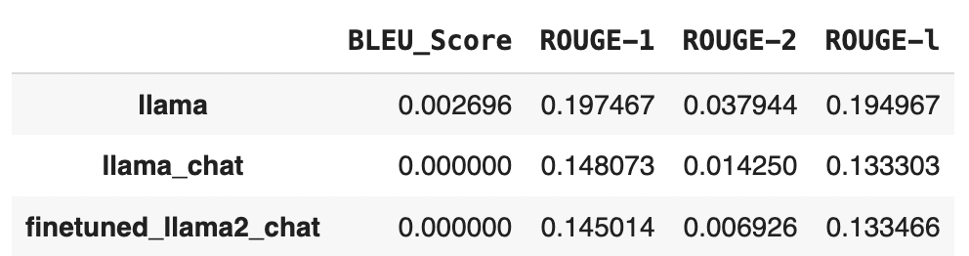
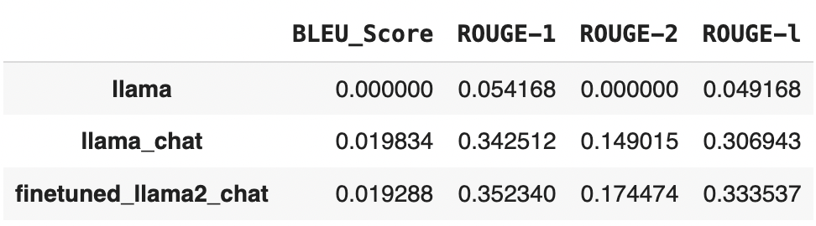
Benchmarking datasets and results
Different models excel on different datasets:
MS_MARCO
TRUTHFUL QA

Slide 21


Conclusion & Our Findings
Best hyperparameter combination
Lora_rank=16,
Gradient Accumulation=2,
Learning_rate=1e-5,
Weight_decay=2e-3,
Max_grad_norm=0.1,
Epoch=10
Best prompting techniques
Templates
Balancing BLEU and ROUGE Metrics in model performance is challenging
akin to precision and recall
Notes:
This is the best com of hp and best prompt engineering techniques based on our experiment.
From this project, we also learned a lesson
Balancing BLEU and ROUGE metrics in model performance is challenging because they focus on different aspects of evaluation. BLEU primarily measures precision, assessing the fraction of the model's generated words that are correct, while ROUGE emphasizes recall, evaluating the fraction of the reference words captured by the model's output. This creates a trade-off similar to the precision-recall balance, where improving one metric may lead to a decrease in the other. Achieving an optimal balance between BLEU and ROUGE requires careful tuning and consideration of the specific requirements of the task at hand.

Slide 22
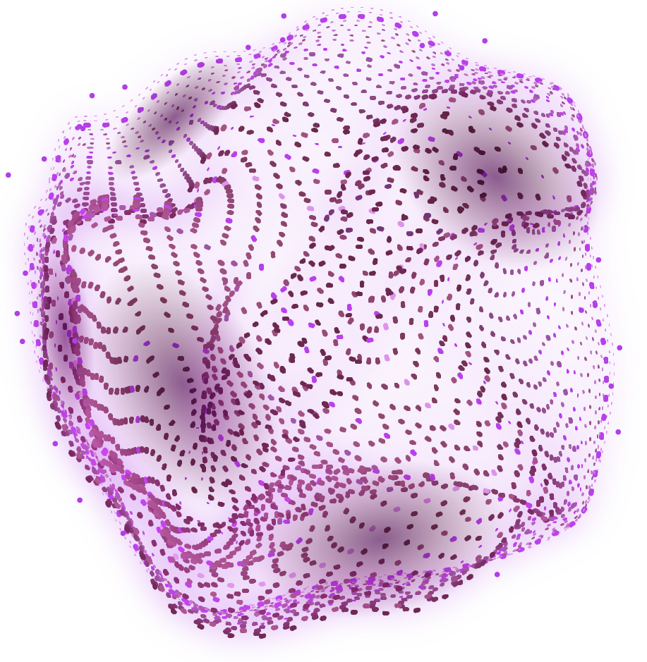
Thanks!

